Slide 1


PANIMALAR ENGINEERING COLLEGE
Department of Computer Science and Engineering
FLUFFY CHARACTER-BASED INFORMATON TRUSTWORTHINESS REVIEWING FOR DEPENDABLE CLOUD CAPACITY FRAMEWORKS
Project Guide:
Mr. N. SATHISH, M.E.,
ASSISTANT PROFESSOR
ASHWIN KUMAR D (211417104027)
BALAJI R (211417104029)
DHESH KUMAAR A (211417104052)
Batch Number: 09

Slide 2
ABSTRACT
Information uprightness, a center security issue in solid distributed storage, has gotten a lot of consideration. Information inspecting conventions empower a verifier to productively check the respectability of the re-appropriated information without downloading the information. A key research challenge related with existing structures of information evaluating conventions is the multifaceted nature in key administration. We try to address the mind-boggling key the board challenge in cloud information honesty checking by presenting fluffy character-based reviewing, the first in such a methodology, to the best of our insight. All the more explicitly, we present the crude of fluffy personality - based information inspecting, where a client's character can be seen as a lot of illustrative traits. We formalize the framework model and the security model for this new crude. We at that point present a solid development of fluffy personality based inspecting convention by using biometrics as the fluffy character. The new convention offers the property of blunder resilience, in particular, it ties with private key to one character which can be utilized to check the rightness of a reaction created with another character, if and just if the two personalities are adequately close. At long last, we build up a model usage of the convention which shows the common sense of the proposition.

Slide 3
LITERATURE SURVEY
Title | Author Name | Year | Findings
NIST Cloud Computing Standards Roadmap | M. Hogan, F. Liu, A. Sokol and J. Tong | August 10, 2011 | The NIST Cloud Computing Standards Roadmap Working Group has surveyed the existing standards landscape for interoperability, performance, portability, security, and accessibility standards/models/studies/use cases/conformity assessment programs, etc., relevant to cloud computing. Using this available information, current standards, standards gaps, and standardization priorities are identified within this document.
A method for obtaining digital signatures and public-key cryptosystem | R. L. Rivest, A. Shamir and L. Adleman | August 8, 2013 | Couriers or other secure means are not needed to transmit keys, since a message can be enciphered using an encryption key publicly revealed by the intended recipient. Only he can decipher the message, since only he knows the corresponding decryption key. A message can be “signed” using a privately held decryption key. Anyone can verify this signature using the corresponding publicly revealed encryption key.

Slide 4
EXISTING SYSTEM
When data owners outsource their data to the cloud, they generally lose physical possession of their data and may have no idea where their data are actually stored or who has the permission to getting access to their data. As a consequence, data owners require a strong integrity guarantee of their outsourced data and they want to make sure that the cloud servers store their data correctly. To solve the aforementioned problems a number of ID-based schemes (including remote data auditing protocols) have been proposed for example, several ID-based remote data auditing protocols were proposed and, in these protocols, identity information is an arbitrary text string. There are a number of limitations inherent in such systems. For example, the user’s identity may not be truly unique if the identity information is not chosen properly Secondly, a user needs to “prove” to the private key generator Centre that he is indeed entitled to a claimed identity, such as presenting a legal document supporting the claim. However, the supporting documents are subject to forgery. Generally, both ID-based and PKI-based schemes rely on what you know (e.g., identity information) and what you have (e.g., digital certificate and password).

Slide 5
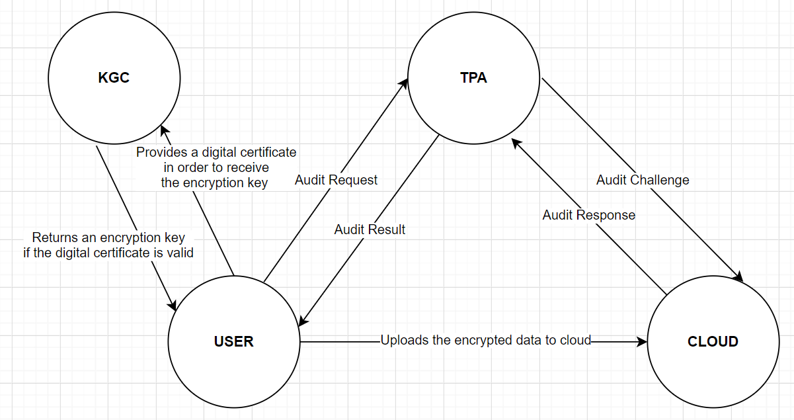
EXISTING SYSTEM

Slide 6
PROPOSED SYSTEM
The existing system is based on public key infrastructure in which the user provides a digital certificate to the KGC in order to receive the encryption key. The problem is that the security of this scheme is purely based on trust, That is we trust that the certificate authority does not issue fake digital certificates. This trust can be broken, So we decided to propose a system which makes use of biometric identity to verify the identity of the person as it is based on what you are. Our system also simplifies the complex task involved in the system which uses digital certificate
(generation, management and revocation of certificates is complex and computationally expensive, and consequently scalability is challenging).

Slide 7
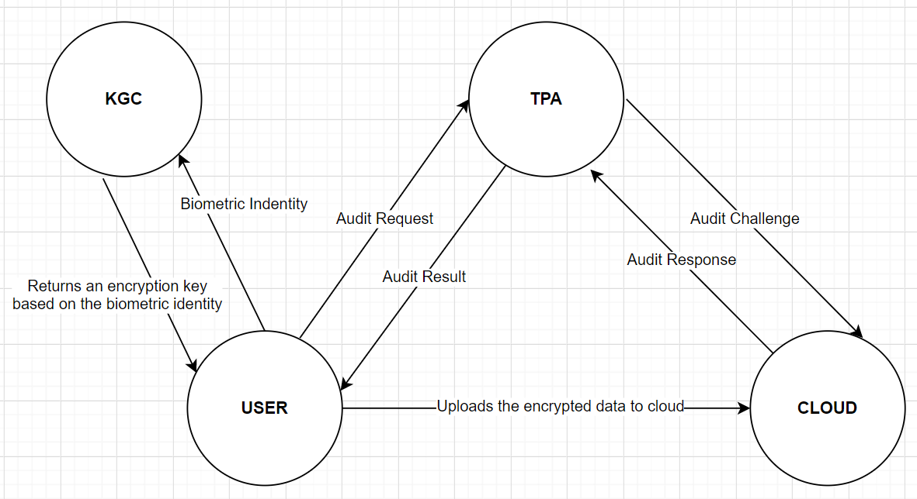
PROPOSED SYSTEM

Slide 8
TECHNOLOGY STACK
HARDWARE REQUIREMENTS
System : Pentium i3 Processor
Hard Disk : 50 GB.
Input Devices : Keyboard, Mouse
Ram : 2 GB
SOFTWARE REQUIREMENTS
Operating system : Windows 10.
Coding Language : JAVA.
Tool : NetBeans 8.2
Database : MYSQL

Slide 9
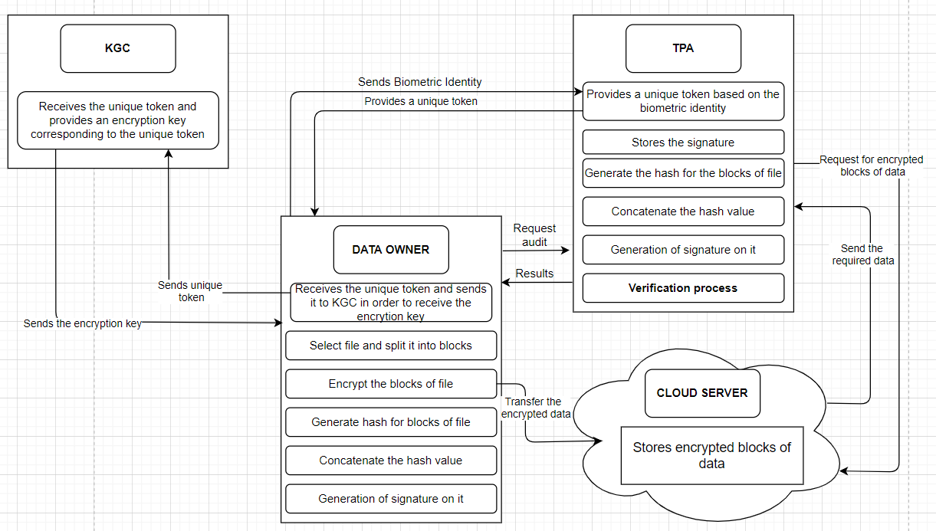
SYSTEM ARCHITECTURE

Slide 10
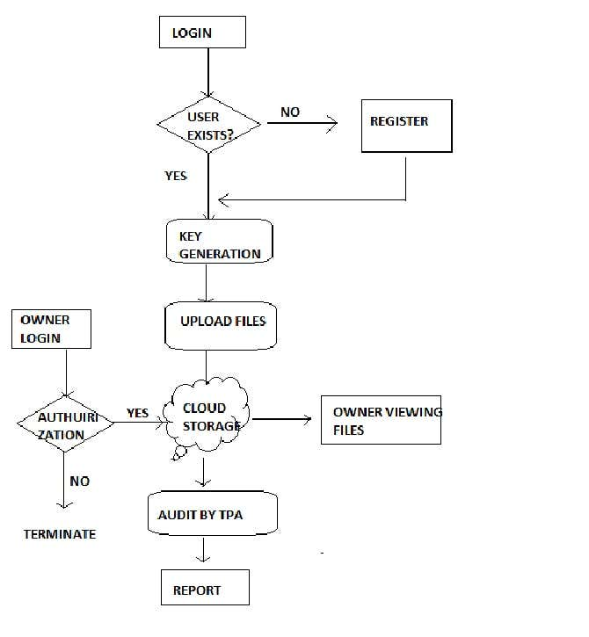
SYSTEM DESIGN – ER DIAGRAM

Slide 11
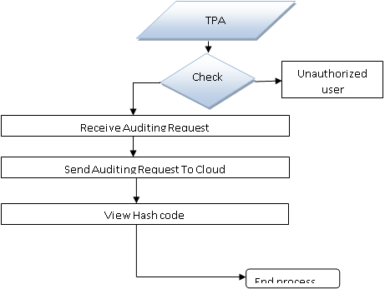
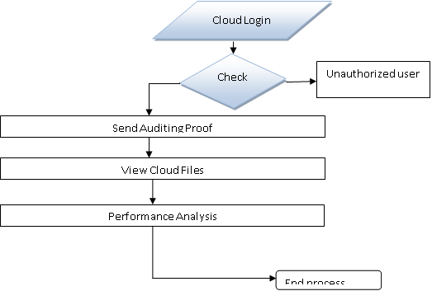
SYSTEM DESIGN – DATAFLOW DIAGRAM
DFD FOR TPA
DFD FOR CLOUD SERVER

Slide 12
SYSTEM DESIGN – USE CASE DIAGRAM

Slide 13
SYSTEM DESIGN – SEQUENCE DIAGRAM

Slide 14
MODULES
1.USER:
In User module, Initially User must have to register their detail. After successful registration data owner can login and upload files into cloud server with encrypted keywords and hashing algorithms. He/she can view the files that are uploaded in cloud. User can approve or reject the file request sent by other users. After request approval data user will send the secret key and verification object through mail.

Slide 15
MODULES
2. THIRD PARTY AUDITOR (TPA):
In TPA module, TPA can receive user file auditing requests and send response to cloud server. Upon receiving the auditing request, TPA and the cloud server execute a challenge-response protocol to verify if the stored file is intact.
3. CLOUD SERVER:
In Cloud Server module, Cloud Provider can view all files details. Cloud can audit user files and generate proof to respected User.

Slide 16
MODULES
4. KEY GENERATING CENTER (KGC):
In KGC module, KGC can view all user details and has authority to approve users and send secret key to respected user. A cloud user forwards his/her attribute set to KGC to request his/her private key. KGC generates a private key for the user with the master secret key and the user’s attributes

Slide 17
TESTING FOR USER MODULE
Test Case Id | Test Cases | Priorit y | Input Test Data | Test Case Description | Expected Results | Actual Results | Pass/Fail
TC0 1 | User registration | A | Enter user details and biometrics | Add user to database | User should be available in database | User present in database | Pass
TC0 2 | User login | A | Enter email id and password | Check the user | User should be available in database | User is present in database | Pass
TC0 3 | OTP Notificatio n | A | - | User enter the OTP for verfication | Notificatio n should be received properly | Mail Message received properly | Pass
TC0 4 | File upload to cloud | A | Enter the file name and select the file | User uploads the file to cloud | Successful uploaded | uploaded successfull y | Pass

Slide 18
TESTING FOR KGC/CLOUD SERVER MODULE
Test Case Id | Test Cases | Priorit y | Input Test Data | Test Case Description | Expected Results | Actual Results | Pass/Fa il
TC0 1 | KGC login | A | Username and password | Verify the KGC login | Kgc login successful | Login success | Pass
TC0 2 | Approve User | A | - | Verify and approve user and send private key to user | Notification should be sent properly | email Messag e sent properly | Pass
Test Case Id | Test Cases | Priority | Input Test Data | Test Case Description | Expected Results | Actual Results | Pass/Fail
TC01 | Cloud login | A | Enter Email-id and Password. | Verify the cloud user | Cloud login successful | Login success | Pass
TC02 | List of Files in cloud | A | - | Uploaded files should be displayed | Should display with hash value | Displayed with hash value | Pass

Slide 19
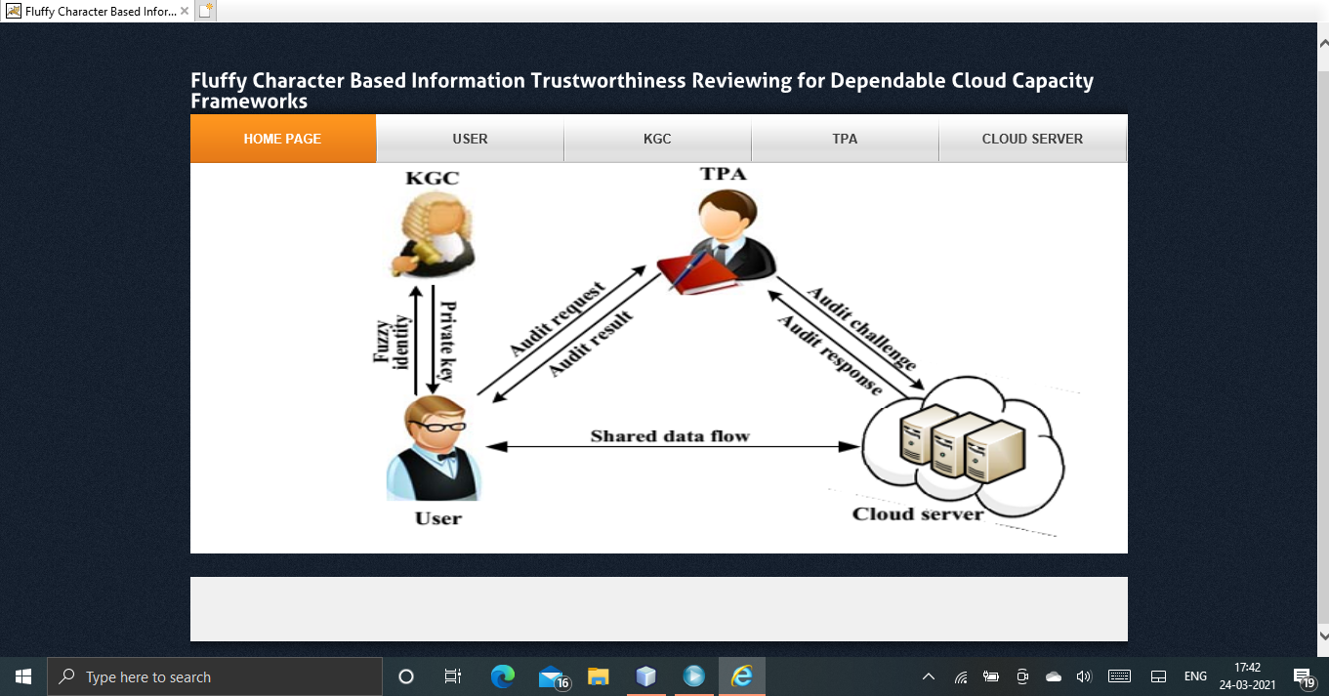
SCREENSHOTS
Home Page

Slide 20
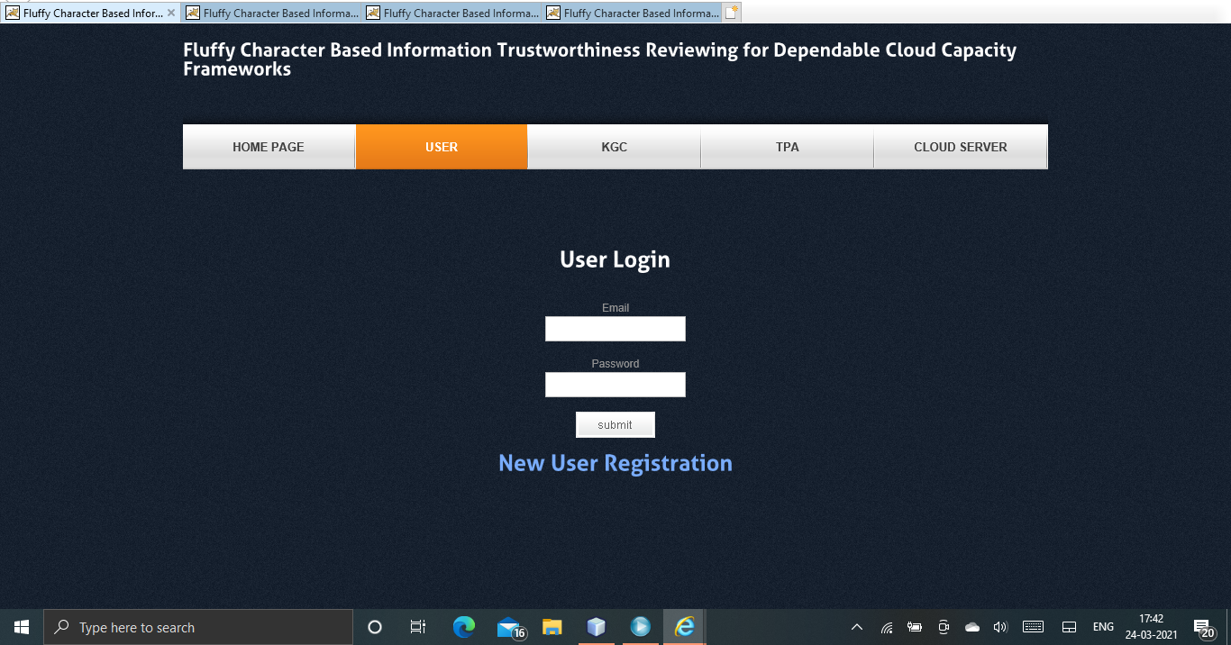
SCREENSHOTS
User Log-In

Slide 21
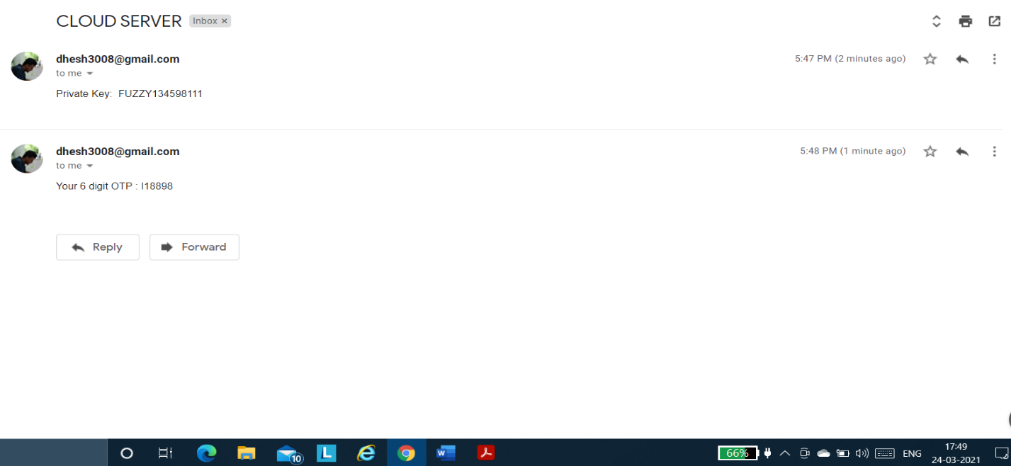
SCREENSHOTS
OTP Sent to Mail

Slide 22
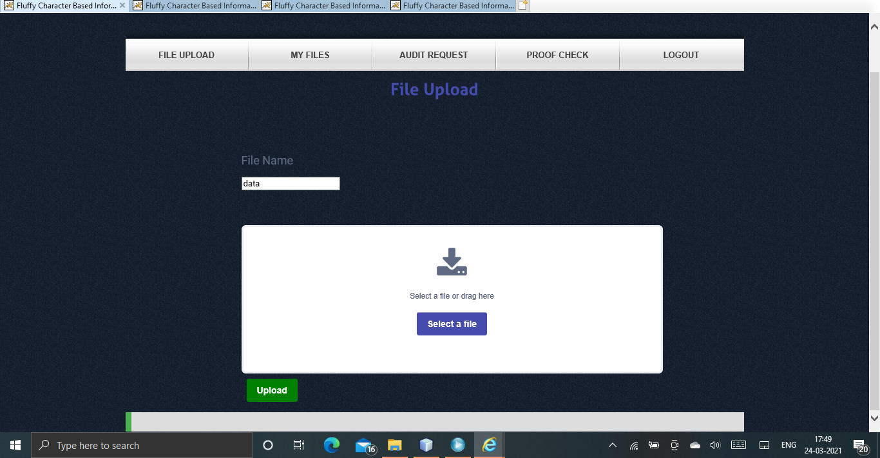
SCREENSHOTS
File Upload

Slide 23
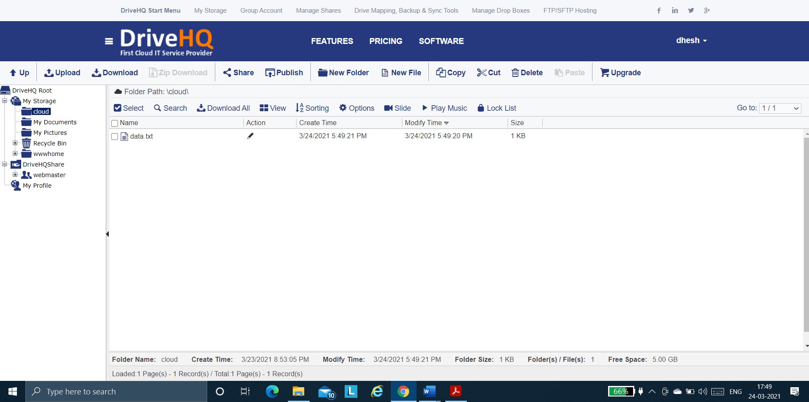
SCREENSHOTS
File Uploaded in Real Time Cloud (DriveHQ)

Slide 24
CONCLUSION
Cloud storage services have become an increasingly important part of the information technology industry in recent years. Thus, ensuring the integrity of data outsourced to the cloud is of paramount importance. In this paper, we presented the biometric based data integrity auditing protocol. The proposed protocol revolutionizes key management in traditional remote data integrity checking protocols. We also presented the the system and security models for this primitive, and a concrete biometric based data integrity auditing protocol using the biometric based identity as an input. We then demonstrated the security of the protocol in the selective-ID model. The prototype implementation of the protocol demonstrates the practicality of the proposal. The existing system is designed in such a way that the data owner submits his/her biometric identity to the KGC in order to receive the encryption key which may lead to security problem as the KGC knows both the biometric identity and the encryption key which can then be used by attackers to access user’s cloud data, So we proposed a secure and privacy auditing scheme which uses the concept of token, The idea is that the data owner submits his/her biometric identity to the TPA and then the TPA returns a unique token to the user based on the biometric received. The data owner then sends the unique token to the KGC in order to receive the encryption key, As a result the KGC only knows the unique token and the encryption key, So the attacker can never know which user uses which unique token.

Slide 25
REFERENCE
Yannan Li, Yong Yu_, Geyong Min, Willy Susilo, Jianbing Ni and Kim-Kwang Raymond Choo, “Fuzzy Identity-Based Data Integrity Auditing for Reliable Cloud Storage Systems”, IEEE Transactions on Dependable and Secure Computing, Volume: 16, Issue: 1, Jan.-Feb. 1 2019.
P. Salil, S. Pankanti and A. K. Jain. “Biometric recognition: Security and privacy concerns.” IEEE Security and Privacy, 2, pp.33-42, 2003.
X. Li, J. Li and F. Huang. “A secure cloud storage system supporting privacy-preserving fuzzy deduplication”. Soft Computing, 20(4), pp. 1437- 1448,2016.
D. Boneh and M. Franklin. “Identity-based encryption from the weil pairing”, Proc. of CRYPTO 2001, LNCS 2139, pp.213-229, 2001.
C. Wang, Q.Wang, K. Ren, and W. Lou, “Privacy-preserving public auditing for data storage security in cloud computing”. Proc. of IEEE INFOCOM, pp.525-533, 2010.
Y. Yu, M.H. Au, Y. Mu, S.H. Tang, J. Ren, W. Susilo and L.J. Dong, “Enhanced privacy of a remote data integrity-checking protocol for secure cloud storage” International Journal of Information Sececurity.14(4), pp.307-318, 2015.

